Slide 1
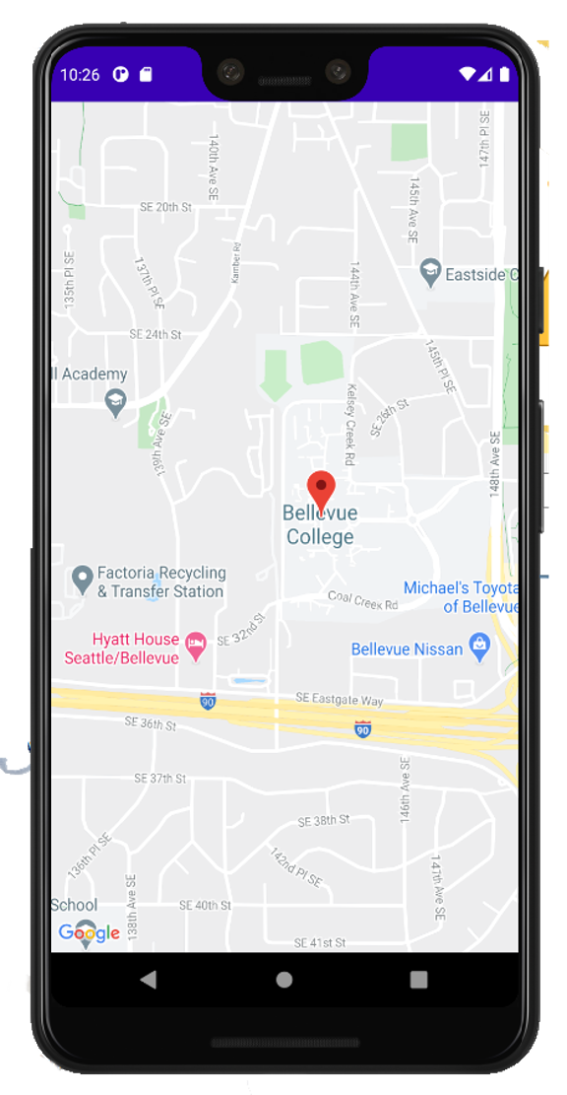

Book Search
Book Search
Book Search
Harry Potter and the Sorcerer’s Stone
Title or Author…
Harry Po|
Harry Potter and the Sorcerer's Stone
:
Located At the following Libraries
Harry Potter and the Chamber of Secrets
Anthony’s Library
<1234 Main St.>
1.
Harry Potter and the Prisoner of Azkaban
Jiayi’s Library
<456 Example Dr.>
2.
Grant’s Library
<789 Basic Blvd.>
3.
Kyle’s Library
<711 Street Rd.>
4.

